Slide 1
Cloud Revolution
Andre Rodrigues
Software Development Engineer
Email: andrerod@microsoft.com
Twitter: @andremrodrigues
Notes:
Hello everyone.
So let’s get this started… my name is Andre Rodrigues and Im a Software Development Engineer at Microsoft.
I’m here today to talk to you about Cloud Computing and how this “new” thing called the cloud is changing the way we think about computers, applications and, all in all, connecting people.

Slide 2
Everything starts with a Problem
Notes:
So it is said that everything starts with a problem.

Slide 3
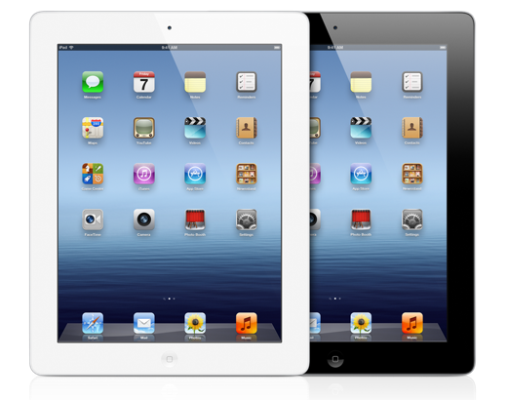
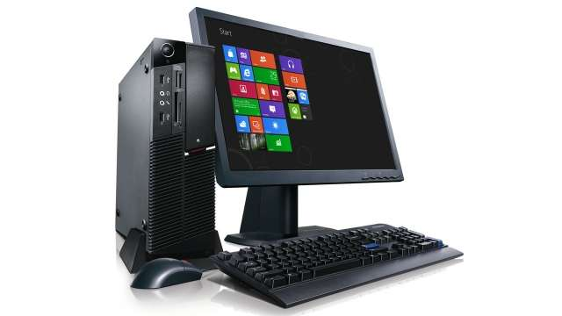
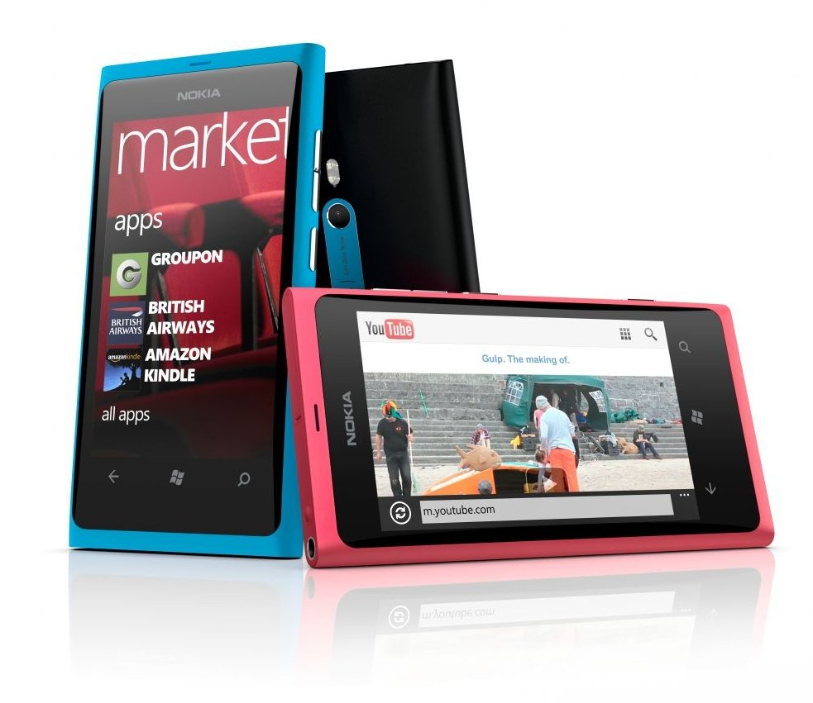

Notes:
Say you want to develop a modern app. chances are that eventually u’d want your app to also work on a tablet, or a PC or even a TV device.
This causes some problems into the services and cloud support you originally created because now you don’t have only 1 device accessing your service, but you have multiple ones, plus you have multiple formats to deliver to.
But that’s not all…

Slide 4

Growing user base
Notes:
Eventually, you get more users, and with those, the need to process their multiple requests

Slide 5
Spikes in demand
Notes:
You get spike in demands, for instance in Christmas, or easter, or even lower demand in the summer.

Slide 6
Potential Entrants
Suppliers
Industry Rivalry
Buyers
Substitutes
Time to market
Notes:
You also start to face some challenges like how to add that new feature fast, or get that new service.

Slide 7



Notes:
So… what do you do ?
Obvious isn’t ? You Deploy some servers, you install some software and you hire administrators to manage all that … that’s it easy. Right ?

Slide 8
Well…
Notes:
Well…

Slide 9
Not really.
Notes:
Not really. You can do better than that.

Slide 10
Cloud Computing
Notes:
There’s this “new” thing called cloud computing

Slide 11


Cloud Services Models
Traditional Software
Infrastructure
(as a Service)
Platform
(as a Service)
Software
(as a Service)
Applications
Applications
You manage
Applications
Applications
Data
You manage
Data
Data
Data
Runtime
Runtime
Runtime
Runtime
Managed by vendor
You manage
Middleware
Middleware
Middleware
Middleware
Managed by vendor
O/S
O/S
O/S
O/S
Virtualization
Virtualization
Managed by vendor
Virtualization
Virtualization
Servers
Servers
Servers
Servers
Storage
Storage
Storage
Storage
Networking
Networking
Networking
Networking

Slide 12
















Cloud based Applications

Slide 13
Making the Move

Slide 14
Choosing a provider
← You can use the tools and languages you already know
← Provides the models that I want – IaaS, PaaS or even BaaS
← Provides the services that I need
← Easy to manage and control

Slide 15


Slide 16

@andremrodrigues

Slide 17

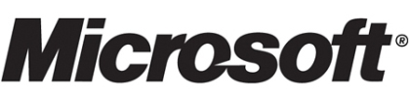

Slide 18

Actually no

Slide 19
Times have changed

Slide 20
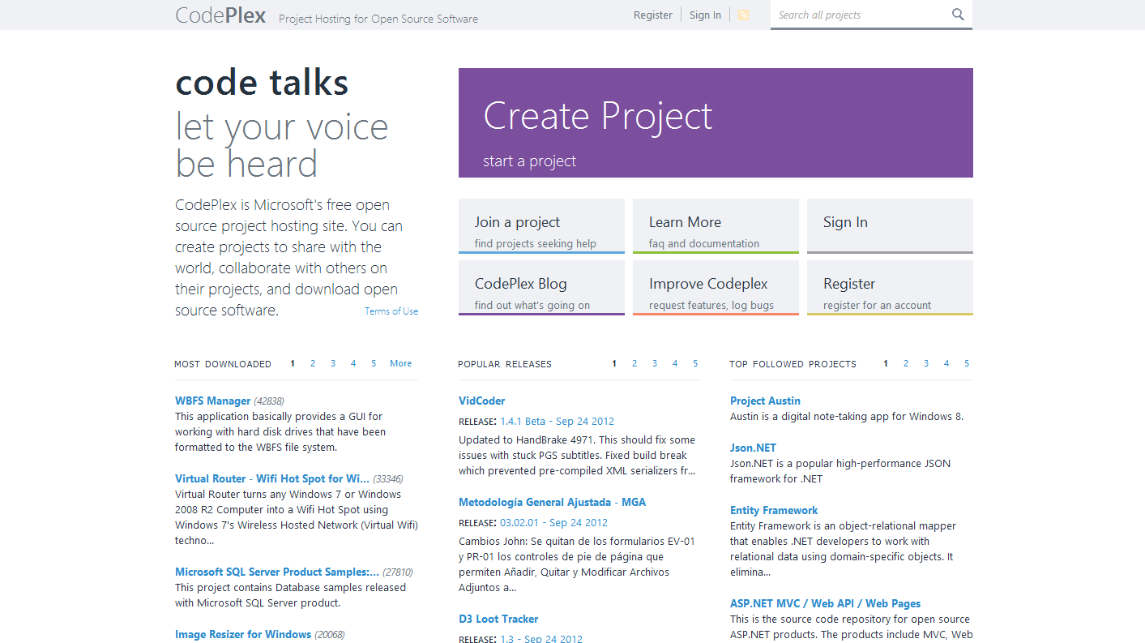
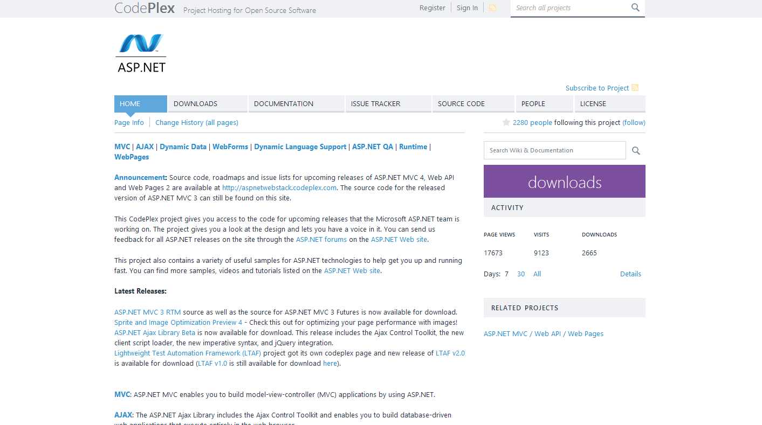
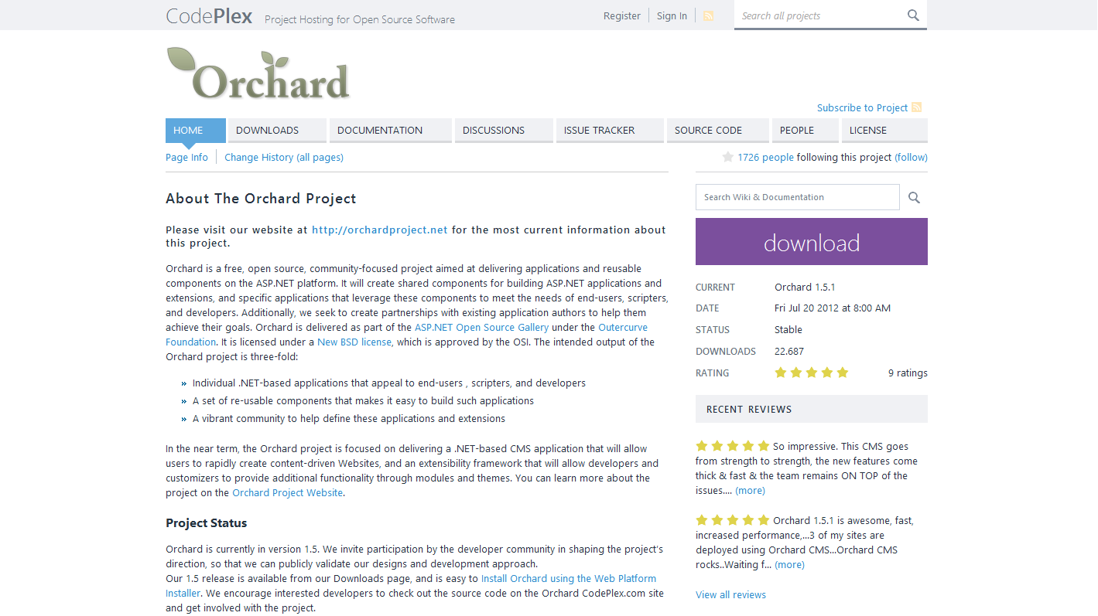
Embracing Open Source
Notes:
Microsoft is actually embracing things like open source where it has even created a foundation, named codeplex, where it makes available source code from some of its products and welcomes new user projects. So everyone can use it free of charges and open up their projects to the world.

Slide 21
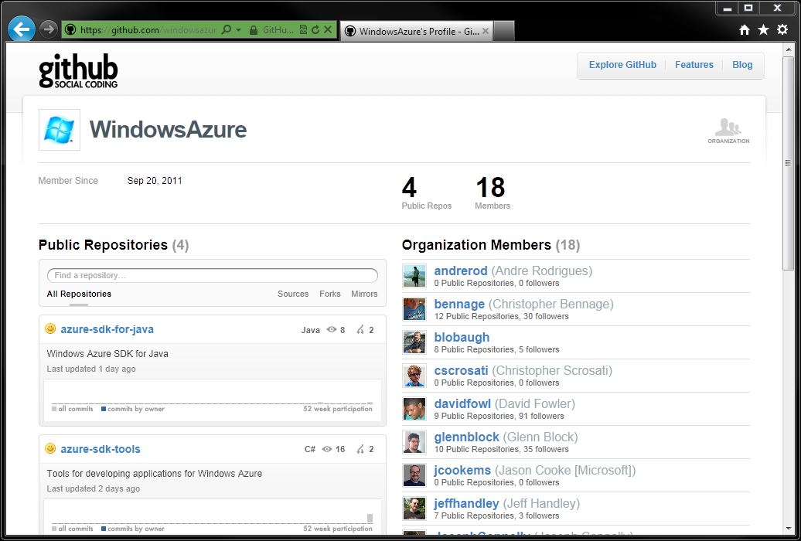
Windows Azure SDKs
open source libraries
Apache 2 License
Multiple Languages
Hosted on GitHub
Contributions Welcome
→ http://github.com/windowsazure
Notes:
This is what has happened with the Windows Azure SDKs which are made available in as open source libraries with an apache 2 license for all its languages, hosted on github and which even welcomes contributions.

Slide 22
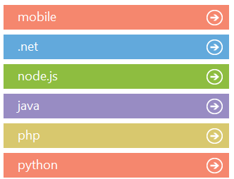
The languages you want to use
And growing …
Notes:
We embrace the languages people want to use. Even the ones that are not originated from Microsoft.
Today we have support for node, Java, PHP, Python and we do have SDKs for Windows Phone, iOS and more will come.

Slide 23
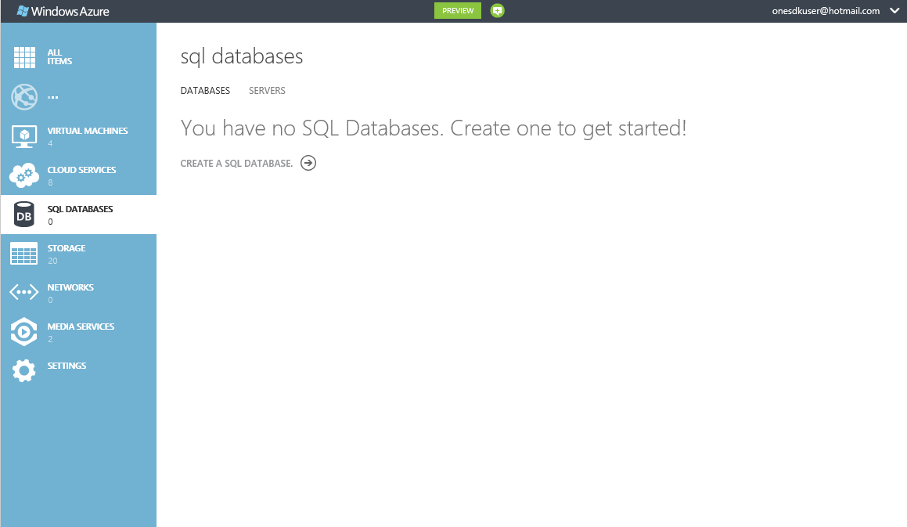
A cross-browser management portal
Notes:
We do have a completely new website, html5 based that works in any modern browser (IE included ☺)

Slide 24



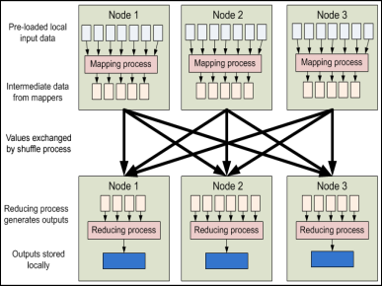


The services you need
CDN
caching
integration
business analytics
identity & security
media
HPC
commerce
compute
data management
networking
cloud services
VMs
websites
SQL database
noSQL database
blob
connect
virtual network
traffic manager

Slide 25
That’s cool and all, but…
Show us how it works

Slide 26
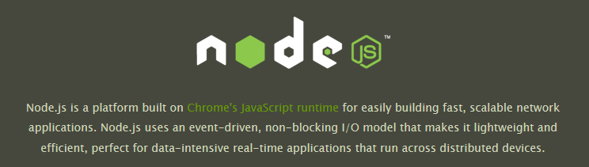

Slide 27
What’s in the box
← Deployment tools – push your app to azure without an expensive IDE https://github.com/WindowsAzure/azure-sdk-tools
← node.js process manager (iisnode) – activation, lifetime management, multi-core support https://github.com/WindowsAzure/iisnode
← Packages for Azure services – use storage and other services from node.js apps https://github.com/WindowsAzure/azure-sdk-for-node

Slide 28
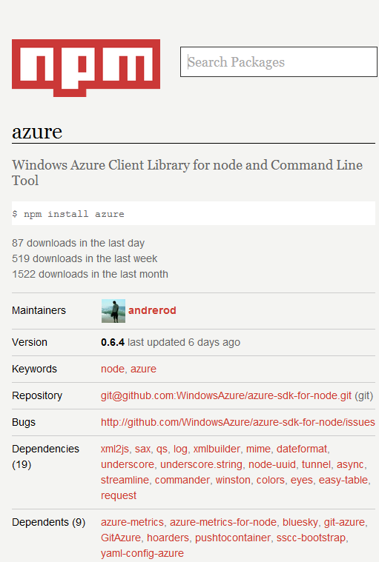
Notes:
Naturally we do have a module / sdk that allows you to use node with windows azure.
This module, which is conveniently maintained by me, is called “azure” and you can easily get it using npm, the package installer in node, by doing npm install azure.

Slide 29
Demo
Notes:
Create a node app that uses table storage locally
Install the cross plat CLI
Create an azure website using it
Deploy my app as a website using Git

Slide 30
www.windowsazure.com

